Slide 2

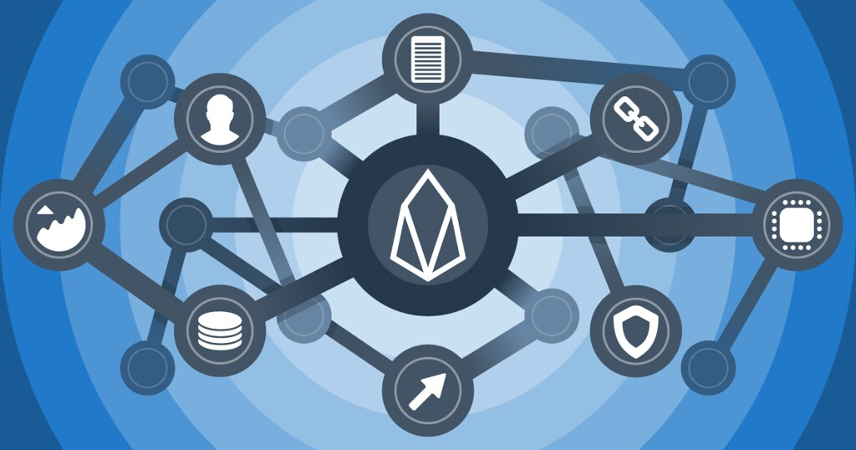
Research Topics in Blockchain
&
Blockchain and Its Application
Bitcoin and Anonymity

Slide 3
Anonymity basics

Slide 4
Some say Bitcoin provides anonymity
“ Bitcoin is a secure and anonymous digital
currency ”
— WikiLeaks donations page

Slide 5
What do we mean by anonymity?
Definition: Anonymity in blockchain refers to the ability of users to participate in transactions without revealing their real-world identities. This is achieved by using cryptographic addresses (like wallet addresses) instead of personal information.However, it's important to distinguish between anonymity and pseudonymity:
Anonymity: True identity is completely hidden.
Pseudonymity: A fixed alias (like a wallet address) is used, which can sometimes be traced back to a real identity through analysis.

Slide 6
Anonymity in computer science
Different interactions of the same user with the system should not be linkable to each other
Anonymity = pseudonymity + unlinkability

Slide 7

. “Anonymity set: the crowd that one attempts to blend into”
✅ What it means:
The anonymity set is the group of people or addresses with whom your activity could plausibly be associated. A larger set = stronger anonymity.
🧠 Think of it like this:
If 100 people are wearing the same mask at a party, it’s hard to know who’s who. But if only 2 people are masked, you’re easier to identify.

Slide 8
Why is unlinkability needed?
Many Bitcoin services require real identity
Linked profiles can be deanonymized by a variety of side channels
Notes:
If linked at any point, all tx’s identified – past, present and future
KYC principle
side channel example: transaction timing correlates with twitter postings

Slide 9
Defining unlinkability in Bitcoin
Hard to link different addresses of the same user
Hard to link different transactions of the same user
Hard to link sender of a payment to its recipient

Slide 10
Privacy of Financial Transactions
In traditional banking, every transaction is tied to your name, ID, and account. In contrast:
With Bitcoin, you don’t need to reveal your real identity to send or receive money.
This protects users from surveillance, identity theft, and unnecessary exposure of spending habits.
No Central Authority to Verify Identity
Bitcoin operates without banks or governments. There’s no one to issue IDs, do KYC, or manage accounts.
Instead of accounts, Bitcoin uses wallet addresses.
These addresses act as pseudonyms that allow users to control their funds independently.
👤 Example: You generate a wallet offline without ever giving your name. You still can receive and send Bitcoin securely.

Slide 11
Quantifying anonymity
In theory, we want every transaction and address on a blockchain to be completely untraceable — that is, unlinkable. If two addresses are unlinkable, no one can figure out whether they belong to the same person.
But in practice, complete unlinkability is very difficult to achieve on most blockchains like Bitcoin or Ethereum. Why?
Notes:
In particular, techniques like “taint” aren’t very good

Slide 12
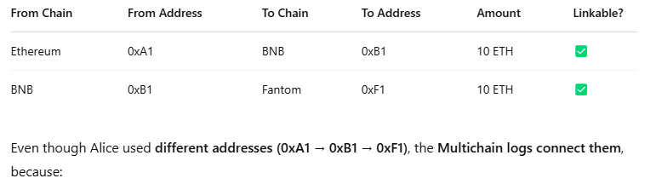
🚨 Why it's hard:
Bitcoin is transparent — all transactions are publicly visible.
Many users reuse addresses or combine inputs, which creates patterns.
Blockchain analytics firms use tools to correlate addresses and deanonymize users.
So, even though Bitcoin doesn’t ask for your name, it doesn’t guarantee unlinkability.

Slide 13
Why anonymous cryptocurrencies?
Block chain based currencies are totally, publicly, and permanently traceable
Without anonymity, privacy is much worse than traditional banking!

Slide 14
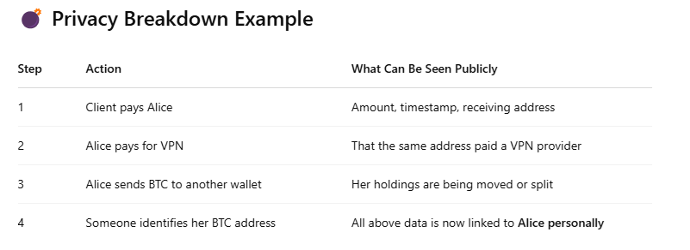
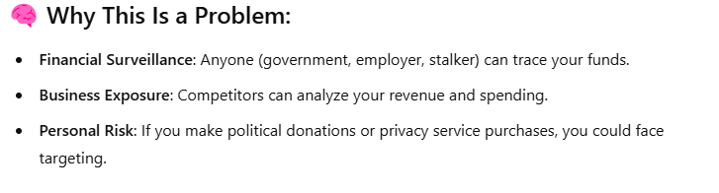

Slide 15
Privacy Features
Feature | Explanation | Purpose / Benefit
Ring Signatures | Combines a group of possible senders in a transaction, hiding the true sender. | Makes it impossible to tell who actually sent the funds.
Stealth Addresses | One-time addresses generated for each transaction, hiding the recipient's real address. | Prevents linking multiple payments to the same receiver.
Confidential Transactions | Hides the transaction amount using cryptographic techniques. | Keeps how much was sent totally hidden.
zk-SNARKs | Zero-knowledge proofs used in Zcash to prove a transaction is valid without revealing details. | Achieves strong privacy while maintaining verifiability.
Coin Mixing / CoinJoin | Combines multiple users' transactions into one to confuse tracking. | Breaks the link between input and output addresses.

Slide 16
Money laundering is the process of disguising the origins of illegally obtained money to make it appear legitimate. Criminals engage in money laundering to integrate their illicit earnings—such as funds from drug trafficking, corruption, cybercrime, or tax evasion—into the legal financial system without drawing attention.
The process typically involves three main stages: placement (introducing the dirty money into the system, e.g., by depositing it in a bank or converting it to cryptocurrency),
layering (conducting complex transactions to obscure the money's origin, such as sending funds through multiple wallets or countries), and integration (reintroducing the cleaned money into the economy, such as buying real estate or luxury goods). In the context of cryptocurrencies, money laundering can involve tactics like using mixers, privacy coins (e.g., Monero), decentralized exchanges, or cross-chain bridges to hide the trail of funds, making it harder for authorities to trace the original source.

Slide 17
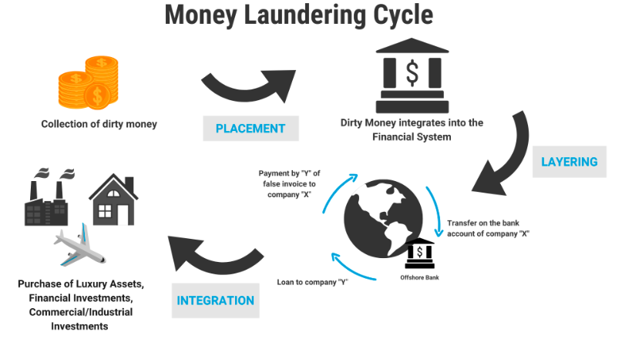
A common myth is that Bitcoin’s pseudonymity makes it a safe haven for money laundering; however, this is far from the truth. While Bitcoin transactions do not include real names, they are permanently recorded on a public ledger that anyone can analyze. Every transaction, amount, and wallet address is traceable using blockchain analytics tools, allowing law enforcement and regulatory bodies to follow the flow of funds with remarkable accuracy. Once a wallet is linked to a real-world identity—such as through a KYC-compliant exchange—all associated transactions can be exposed. In fact, Bitcoin’s transparency has helped solve numerous cybercrime cases, recover stolen funds, and support financial investigations. So, rather than being an ideal tool for laundering money, Bitcoin’s traceable nature often works against criminals, making it a less attractive option for hiding illicit gains.

Slide 18
What about money laundering?
Legitimate worry
Bottleneck: moving large flows into and out of Bitcoin (“cashing out”)
Notes:
Researchers should work with AML. Pointer to next lecture
Even for traditional money laundering, difficulty is not technical but rather criminal penalties
Efforts to improve Bitcoin anonymity don’t solve the cashing out problem, so nothing to worry about there

Slide 19
Can we keep only the good uses?
Common conundrum in computer security and privacy:
uses that are very different morally are pretty much the same technologically

Slide 20
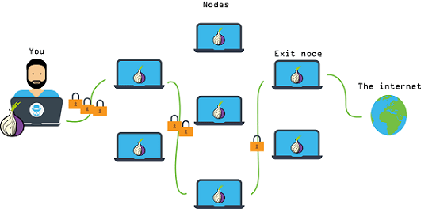
Similar dilemma: Tor
Anonymous communication network
Sender and receiver of message unlinkable
Used by:
Normal people
Journalists & activists
Law enforcement
Malware
Funded by (among others):
U.S. State Department

Slide 21
Anonymous e-cash: history
Crypto
magic
David Chaum, 1982
Blind signature:
two-party protocol to create digital signature without signer knowing the input

Slide 22

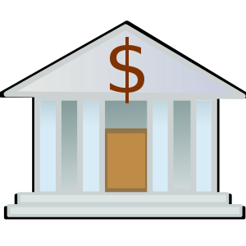

Anonymous e-cash via blind signatures
User | Balance
… | …
 | 10
… | …
 | 5
Spent coins
…
Withdraw anonymous coin
{317038628684424}
9
31703862…
Deposit coin # 317038628684424
{317038628684424}
6
OK
Bank cannot link the two users

